Slide 1
Information System
ITEC-522
5th Semester Third Year
Information Technology
Dr. Khalil-ur-Rahmen Khoumbati
Professor
Department of Information Technology
Faculty of Engineering and Technology
University of Sindh, Jamshoro
Khalil.khoumbati@gmail.com
Week-6

Slide 2
Enterprise Systems
What are enterprise systems
  Suite of integrated software modules and a common central database
  Collects data from many divisions of firm for use in nearly all of firm’s internal business activities
  Information entered in one process is immediately available for other processes
© Prentice Hall 2011

Slide 3
Cont.
Enterprise Software
  Built around thousands of predefined business processes that reflect best practices
    Finance/accounting: General ledger, accounts payable, etc.
    Human resources: Personnel administration, payroll, etc.
    Manufacturing/production: Purchasing, shipping, etc.
    Sales/marketing: Order processing, billing, sales planning, etc.
  To implement, firms:
    Select functions of system they wish to use
    Map business processes to software processes
      Use software’s configuration tables for customizing
© Prentice Hall 2011

Slide 4
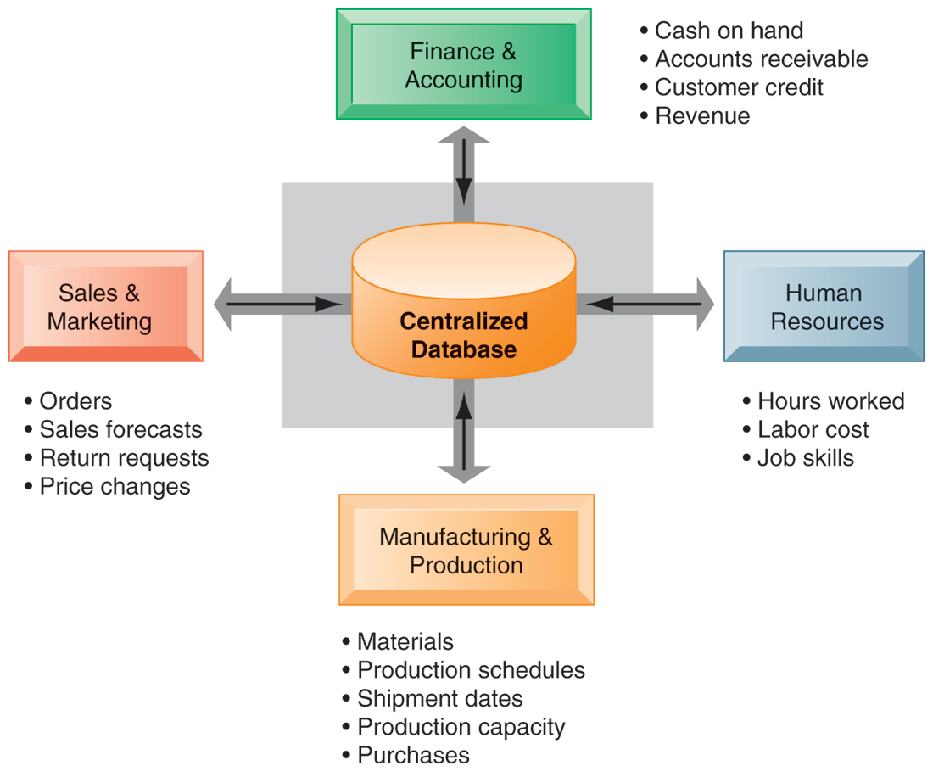
How Enterprise Systems Work
© Prentice Hall 2011

Slide 5
Cont.
Enterprise systems feature a set of integrated software modules and a central database that enables data to be shared by many different business processes and functional areas throughout the enterprise.
Enterprise systems are classified in three main categories:
Enterprise Resource Planning System
Supply Chain Management System
Customer Relationship Management System

Slide 6
Enterprise Resource Planning ( ERP) Systems
Interdependent software modules with a common central database that support basic internal business processes for finance and accounting, human resources, manufacturing and production, and sales and marketing.
“a business strategy and set of industry-domain-specific applications that build customer and shareholder communities value network system by enabling and optimising enterprise and inter-enterprise collaborative operational and financial processes”( Source: Gartner’s Research Note SPA-12-0420)

Slide 7
Historical system architectures
Historically, organizations created “islands of automation”.
Various systems that operated or managed various divergent business processes. Sometimes these systems were integrated with each other and sometimes they weren’t. Sometimes they were loosely interfaced and sometimes they were more tightly interfaced.
Notes:
It's month end, now comes the reconciliation crunch Appsworld January 2004
Prepared by : Richard Byrom - RPC Data

Slide 8
ERP Packages
Integrated systems
Examples
  SAP
  PeopleSoft
  Oracle Financials
International environment
  Multiple currencies
  Multiple languages
  Procedures and practices
  Follows local (national) rules
  Follows consolidation rules
  Example
    U.S. firm with European subsidiaries.
    Data is entered once
    European reports are generated for subsidiaries following local rules
    Results are converted and consolidated to U.S. firm following international and U.S. rules

Slide 9
ERP Primary Functions
Accounting
  All transaction data and all financial statements in any currency
Finance
  Portfolio management and financial projections
Human Resources Management
  Employee tracking from application to release
Production Management
  Product design and manufacturing lifecycle
Logistics/Supply Chain Management
  Purchasing, quality control, tracking
Customer Relationship Management
  Contacts, orders, shipments

Slide 10
SAP
Based in Germany, now worldwide
Support for international transactions and multinational firms
Runs on multiple database and hardware platforms
Can handle large and small companies
Expensive, but price is relative.
Financials
Logistics
Human resource management

Slide 11
SAP Financials
Financial Accounting
  General ledger
  Accounts receivable/payable
  Special ledgers
  Fixed assets
  Legal consolidation
Investment Management
  Investment planning/budgeting/control
  Depreciation forecast/simulation/calculate
Controls
  Overhead cost
  Activity based costing
  Product cost
  Profitability analysis
Treasury
  Cash management
  Treasury management
  Market risk management
  Funds management
Enterprise Control
  Executive information system
  Business planning and budgeting
  Profit center accounting
  Consolidation

Slide 12
SAP Logistics
Purchasing
Materials management
Manufacturing
Warehousing
Quality management
Plant maintenance
Service management
Sales
Distribution
Product data management
  Master data management
  Design and change process
  Product structure
  Development projects
Sales and distribution
  Sales activities
  Sales order management
  Shipping and transportation
  Billing
  Sales information system

Slide 13
SAP Logistics
Production planning and control
  Production planning
  Material requirements planning
  Production control and capacity planning
  Costing
  Order information system
  Shop floor information system
Project system
  Work breakdown structures
  Network planning techniques, milestones
  Cost, revenue, financial, schedule, and resource management
  Earned value calculation
  Project information system

Slide 14
SAP Logistics
Materials management
  Purchasing
  Inventory management
  Warehouse management
  Invoice verification
  Inventory controlling
  Purchasing information system
Quality management
  Quality planning
  Quality inspections
  Quality control
  Quality notifications and certificates
  Quality management information system
Plant maintenance
  Structuring technical systems
  Maintenance resource planning
  Maintenance planning
  System for technical and cost accounting data
  Maintenance information system

Slide 15
SAP HRM
Personnel management
  HR master data
  Personnel administration
  Information systems
  Recruitment
  Travel management
  Benefits administration
  Salary administration
Organizational management
  Organization structure
  Staffing schedules
  Job descriptions
  Planning scenarios
  Personnel cost planning
Payroll accounting
  Gross/net accounting
  History function
  Dialog capability
  Multi-currency capability
  International solutions
Time management
  Shift planning
  Work schedules
  Time recording
  Absence determination
  Error handling

Slide 16
SAP HRM
Personnel development
  Career and succession planning
  Profile comparisons
  Qualifications assessments
  Additional training determination
  Training and event management
Other features
  SAP Business workflow
  Internet scenarios
  Employee self-service

Slide 17
ERP – Key Characteristics
Integration
seamless integration of all the information flowing through a company – financial and accounting, human resource information, supply chain information, and customer information.

Slide 18
Cont.
Best Practices
ERP vendors talk to many different businesses within a given industry as well as academics to determine the best and most efficient way of accounting for various transactions and managing different processes. The result is claimed to be “industry best practices”.
The general consensus is that business process change adds considerably to the expense and risk of an enterprise systems implementation. Some organisations rebel against the inflexibility of these imposed business practices.

Slide 19
Cont.
Packages
Enterprise systems are not developed in-house
IS life cycle is different
  Mapping organizational requirements to the processes and terminology employed by the vendor.
  Making informed choices about the parameter setting.
Organizations that purchase enterprise systems enter into long-term relationships with vendors.

Slide 20
Cont.
Some Assembly Required
Only the software is integrated, not the computing platform on which it runs. Most companies have great difficulty integrating their enterprise software with a package of hardware, operating systems, database management systems software, and telecommunications suited to their specific needs.
Interfaces to legacy systems
Third-party applications
Best of Breed Strategy

Slide 21
Cont.
Evolving
Enterprise Systems are changing rapidly
Architecturally: Mainframe, Client/Server, Web-enabled and Object-oriented
Functionally: front-office (i.e. sales management), supply chain (advanced planning and scheduling), data warehousing, specialised vertical industry solutions, etc.

Slide 22
Benefits and Challenges of ERP Systems
Benefits
  Firm structure and organization: One Organization
  Management: Firm wide Knowledge-based Management Processes
  Technology: Unified Platform
  Business: More Efficient Operations and Customer-driven Business Processes
Challenges
  Implementation is an issue
  High Up-front Costs and Future Benefits
  Inflexibility

Slide 23
Supply Chain Management System
Network of organizations and business processes for procuring raw materials, transforming into products, and distributing them to customers
Materials, information, and payments flow through the supply chain in both directions.
Coordination of business processes to speed information, product, and fund flows up and down a supply chain to reduce time, redundant effort, and inventory costs

Slide 24
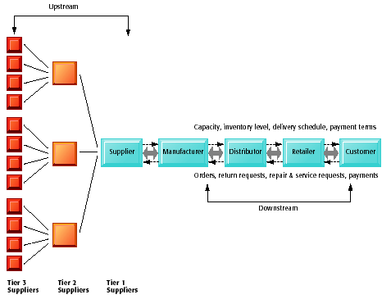
Cont.
A Supply Chain

Slide 25
Supply Chain Management
Design feasibility
& production costs
Design &
Engineering
Designs and Quality
Marketing
product planning
Quality control
& Custom orders
planning
& monitoring
Manufacturing
planning
& monitoring
Vendors
Customers
Purchasing
Distribution
Demand-pull
Mass
Customization
Quick
Response
Just-in-Time
partnerships
& joint
development
Administration & Management
partnerships
& joint
development
HRM
Accounting
Finance
MIS

Slide 26


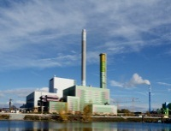

Purchasing/Logistics
Buyer
Suppliers
Identify product features Request for Proposal Evaluate suppliers Negotiate contract Identify exact items and costs Correct errors Receive products Match receipts against order Return items Pay supplier | Provide product details Negotiate contracts Verify orders and times Correct errors Schedule delivery Monitor shipments Handle returns Monitor payments

Slide 27
Supply Chain Processes
SCOR (Chain Operations Reference Model) identifies five major supply chain processes:
Plan: Balancing demand and supply to meet sourcing, production, and delivery requirements
Source: Procurement of goods and services needed to create a product or service.
Make: Processes that transform a product into a finished state.
Deliver: Processes to manage order transportation and distribution
Return: Processes associated with product returns and post delivery customer support

Slide 28
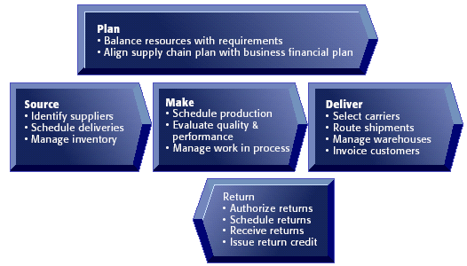
SUPPLY CHAIN MANAGEMENT SYSTEMS
Key Supply Chain Management Processes
Figure 11-4

Slide 29
Supply Chain Management Applications
Supply chain management systems: Automate flow of information between company and supply chain partners.
Supply chain planning systems: Generate demand forecasts for a product (demand planning) and help develop sourcing and manufacturing plans for that product.
Supply chain execution systems: Manage the flow of products through distribution centers and warehouses to ensure that products are delivered to the right locations in the most efficient manner

Slide 30
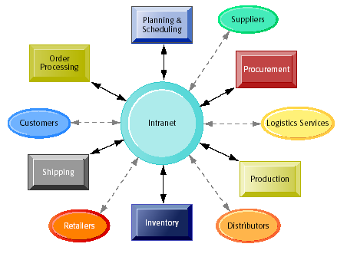
Supply Chain Management and the Internet
Intranets and Extranets for Supply Chain Management

Slide 31
Cont.
Internet-based supply chain management applications:
Provide standard set of tools
Facilitate global supply chains
Enable efficient customer response
Allow concurrent supply chains

Slide 32
Customer Relationship Management
“An integrated sales, marketing & service strategy”
Kalakota & Robinson
“A business strategy to select and manage the most valuable customer relationships. CRM requires a customer-centric business philosophy and culture to support effective marketing, sales, and service processes” - Bob Thompson – CRMGuru.com
IT definition
“Methodologies, software and usually internet capabilities that help an organisation manage customer relationships in an organised manner”

Slide 33
Cont.
“An approach which effectively manages customer relationships”
“A business strategy which pro-actively builds a bias or preference for an organisation with its individual employees, channels and customers resulting in increased [customer] retention and increased performance”
(Carlson Marketing Group 2001)

Slide 34
Customer Relationship Management Applications
CRM systems:
Capture and integrate customer data from all over the organization
Consolidate and analyze the data
Distribute results to various systems and customer touch points across the enterprise

Slide 35
CRM Objectives
Use existing customer relationships to grow revenue.
Use integrated information systems & services to better serve customer needs.
Introduce more excellent repeatable sales processes and procedures.
Create new value and instil loyalty.
Overall more pro-active strategy towards customer focus.

Slide 36
Customer Relationship Management (CRM) Software
Can range from niche tools to large-scale enterprise applications
Can link to other major enterprise applications, such as supply chain management
Can include modules for PRM and employee relationship management (ERM)

Slide 37
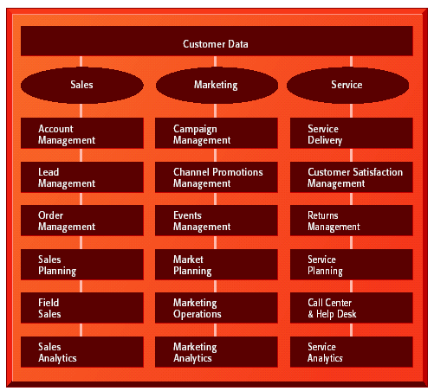
CRM Software Capabilities

Slide 38
CRM - Stages
Customer Acquisition
  Promotion of products – build a relationship – first date
Customer Extension
  An established relationship – cross-selling & up-selling
Customer Retention
  Adapt to customer requirements – requires a complex understanding of customer needs.
  Can an organisation pursue all 3 objectives – extremely difficult

Slide 39
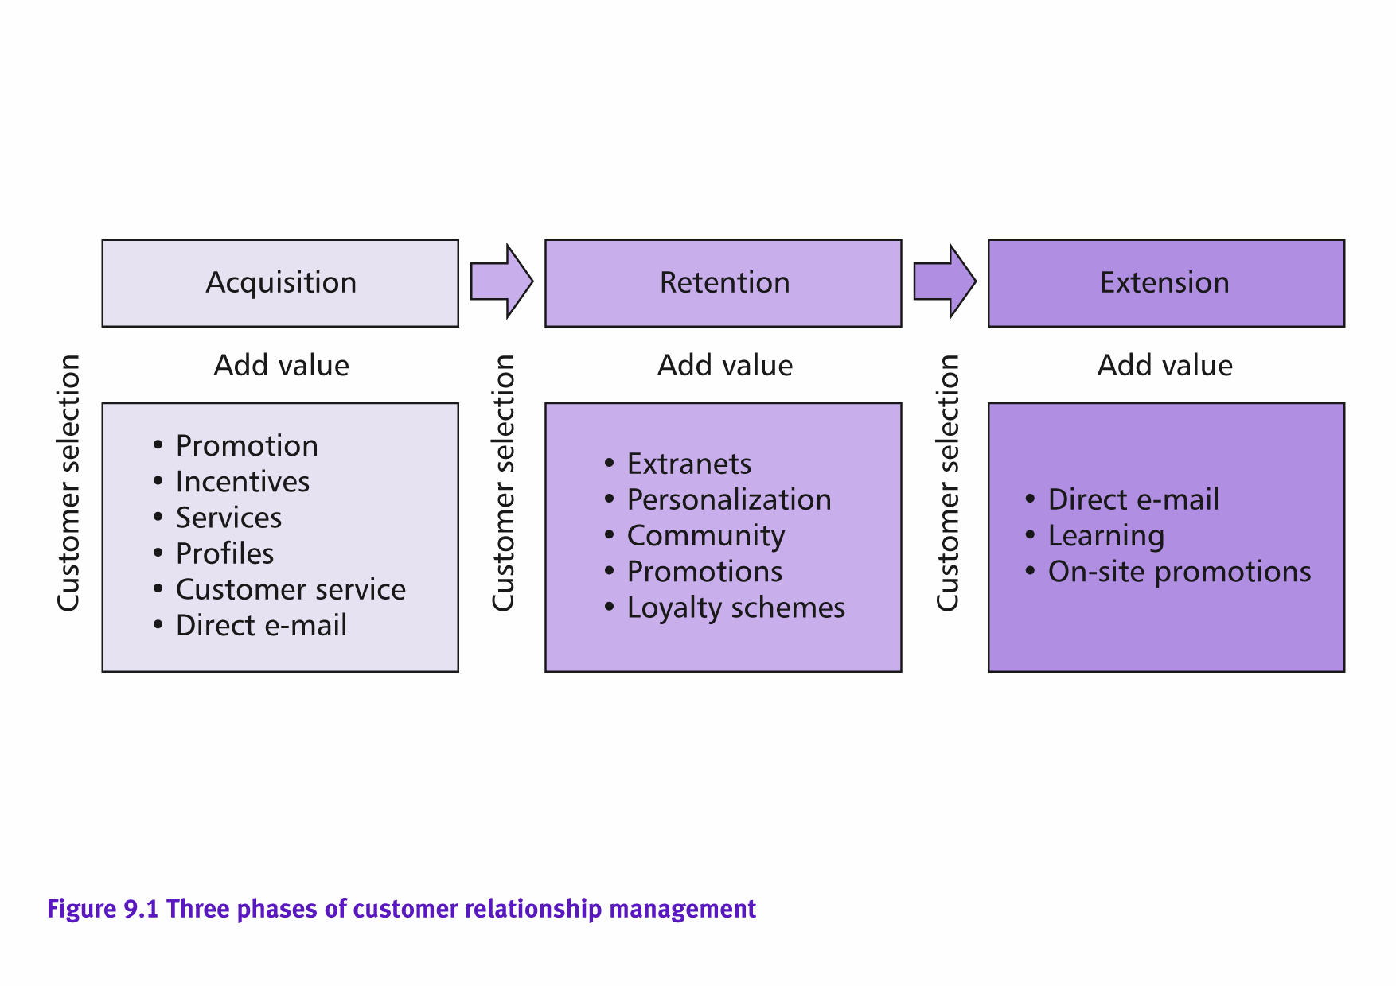
Chaffey’s 3 phases of CRM

Slide 40
CRM – Put into Practice
Requires the development of a set of integrated applications that address all aspect of front-office needs.
  Automate customer service
  Cross Sell & Up-selling activities
  Facilitate field services
  Customer Service and Support – help desks etc
  Support Sales & marketing activities
Organise around the customer – the new CRM oriented architecture
Move away from fragmented organisational & functional structures
Manage all activities that identify, attract and retain customers

Slide 41
CRM – the way forward
Implement a customer focussed strategy before a technological CRM strategy
Customer focus has to be implemented first.
Low tech solutions can be implemented appropriately
Beware of scaring away the customer

Slide 42
Discussion
Questions?

